Slide 1
Shipment Delay Analysis Overview

Slide 2
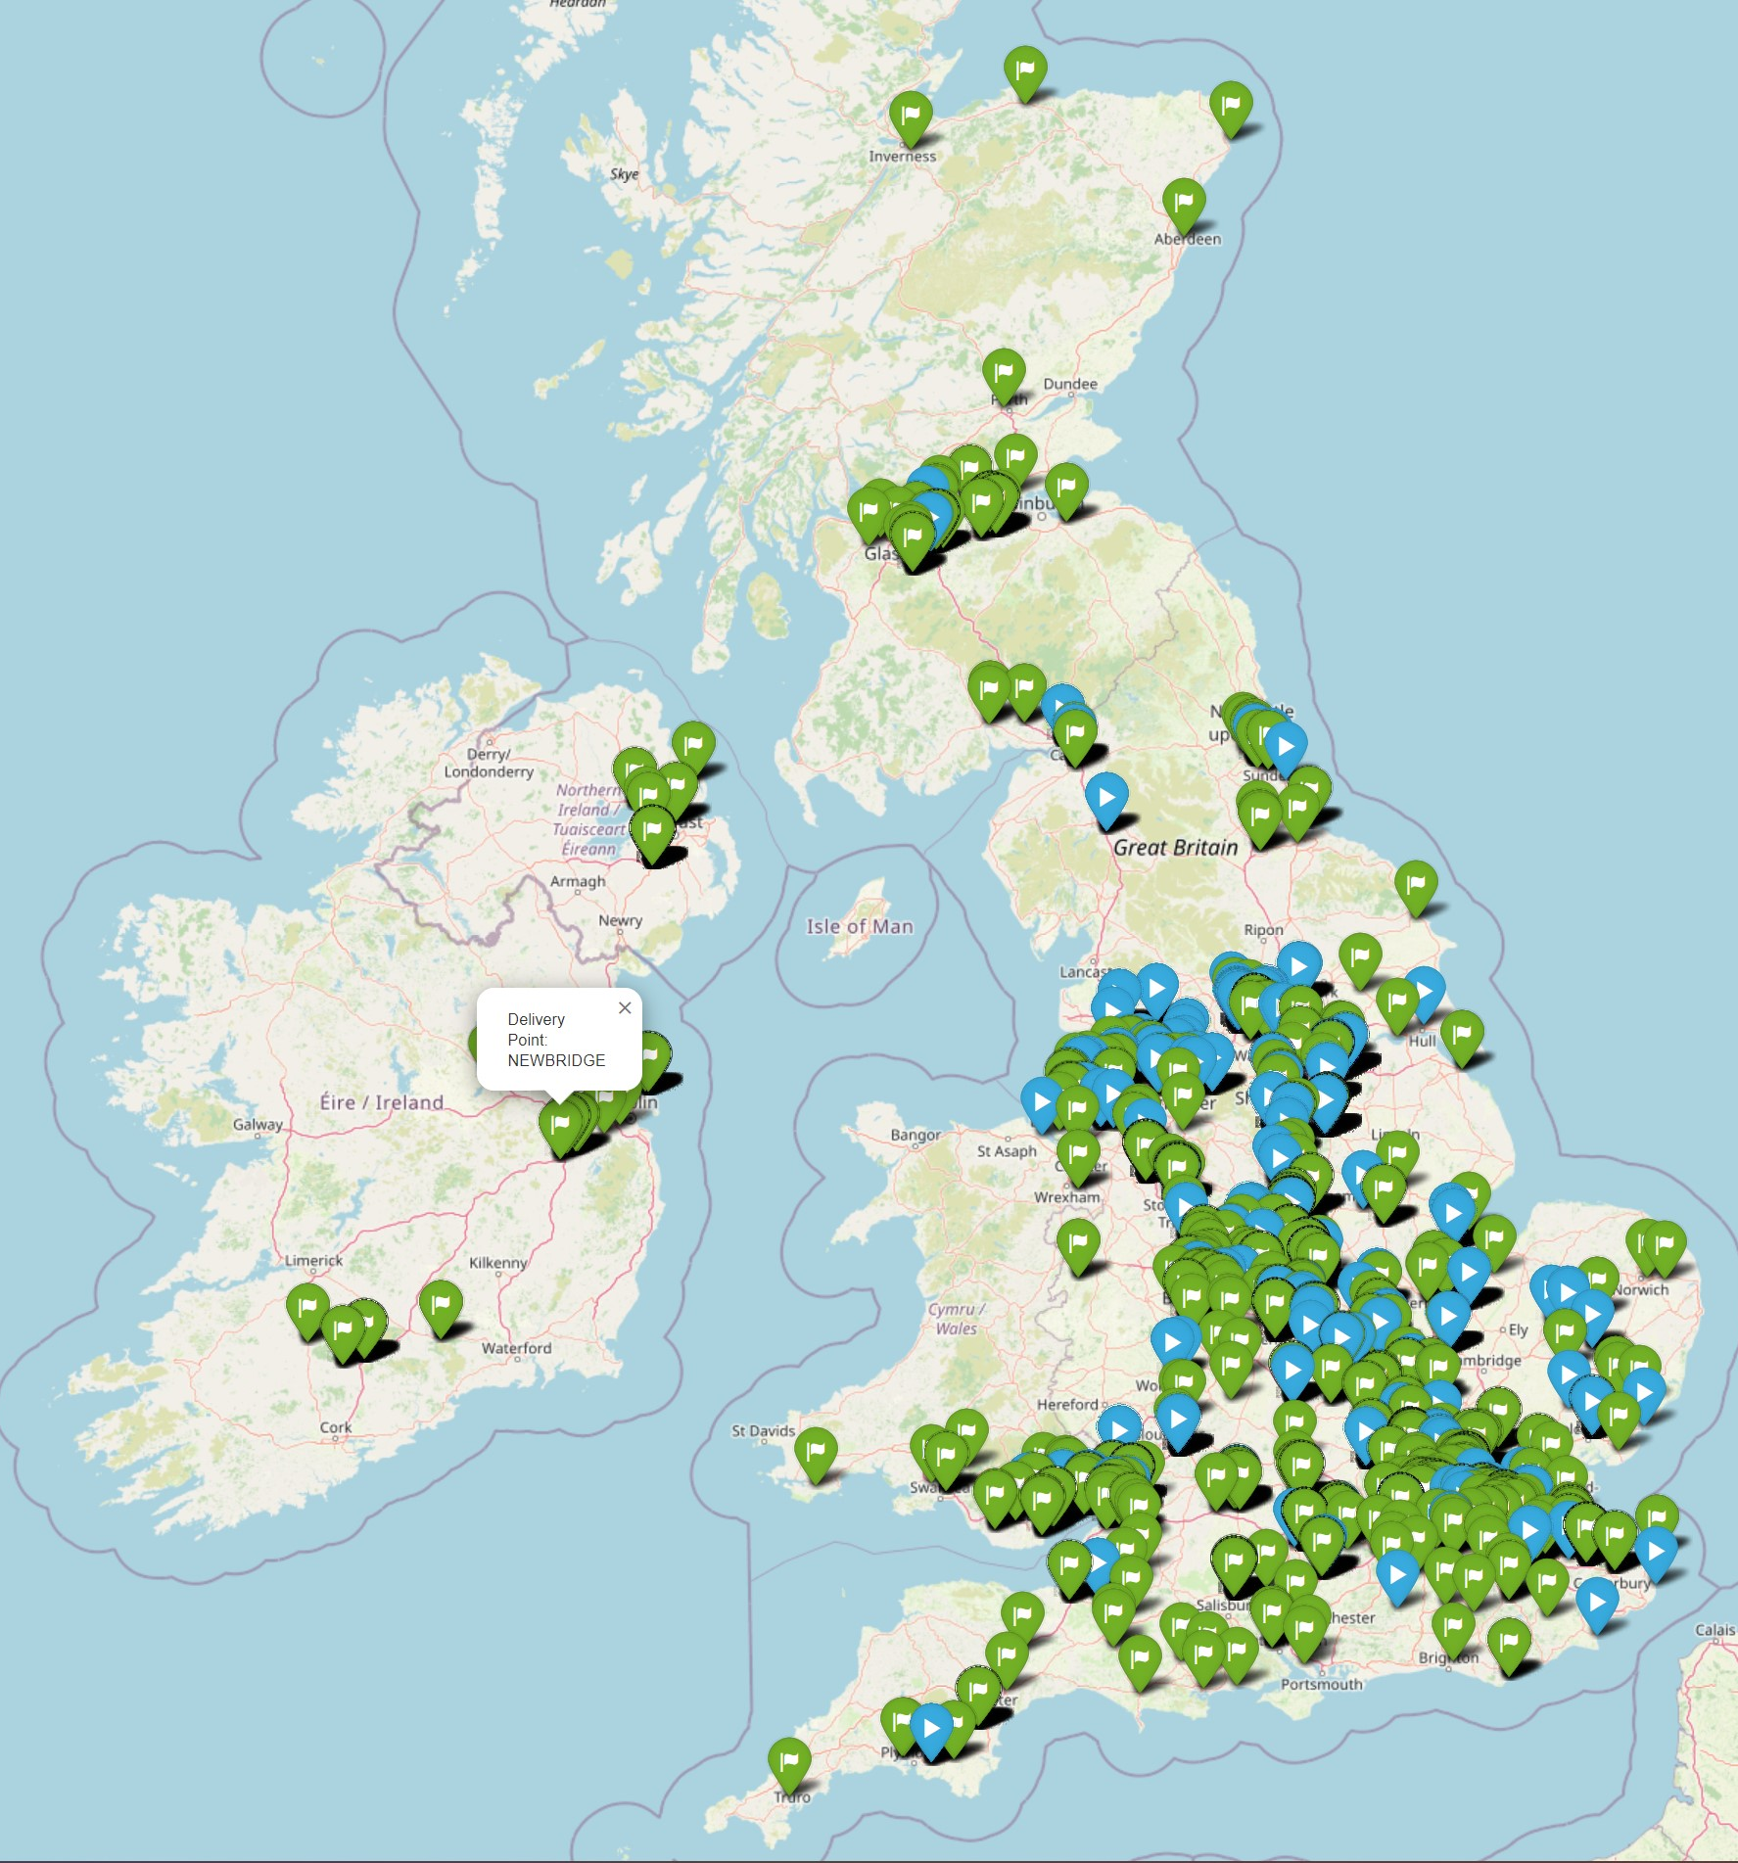
Introduction
Project Goals:
Analyse shipment data: Identify patterns and predict potential delays.
Improve delivery performance: Enhance on-time delivery rates and optimize logistics.
Importance of Shipment Timing and Efficiency:
Customer Satisfaction: Timely deliveries are crucial for maintaining customer trust and satisfaction.
Operational Efficiency: Efficient shipment processes reduce costs and improve resource allocation.
Competitive Advantage: Reliable delivery performance helps the company stay competitive in the market.

Slide 3
Objectives
Goal: Improve shipment delivery performance through data analysis and predictive modelling.
Specific Objectives:
Assess On-Time Deliveries: Calculate the percentage of shipments delivered within their scheduled time frames.
Identify Delay Factors: Determine the key factors contributing to shipment delays.
Predict Future Delays: Develop a predictive model to forecast potential future delays and enhance proactive measures.

Slide 4
Methodology
Data Collection and Analysis:
Data Sources: Shipment booking data and GPS tracking data.
Integration: Combined static shipment data with real-time GPS data.
Tools and Technologies Used:
Python: Used for data analysis and modelling. Allows efficient data handling and manipulation.
Pandas: A powerful data organization tool that helps clean, structure, and analyse data.
Google Maps API: Provides real-time traffic analysis and estimated travel distance.
Simplified Process Overview:
Data Cleaning: Removing inconsistencies and ensuring data quality.
Feature Engineering: Creating meaningful features from raw data (e.g., travel distance, number of route segments).
Predictive Modelling: Using historical data to train models that forecast potential delays.

Slide 5
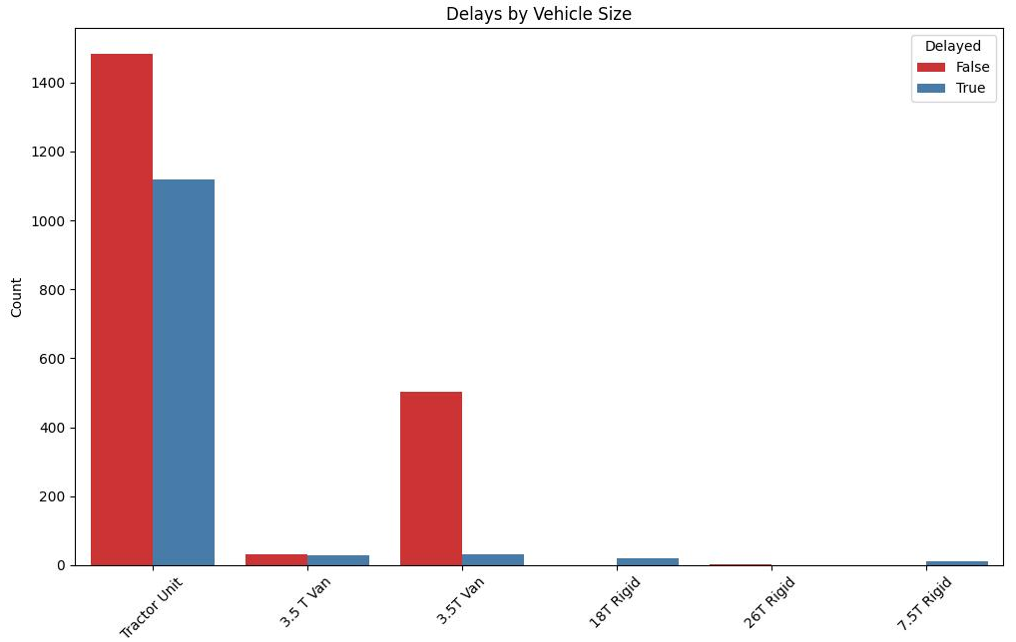
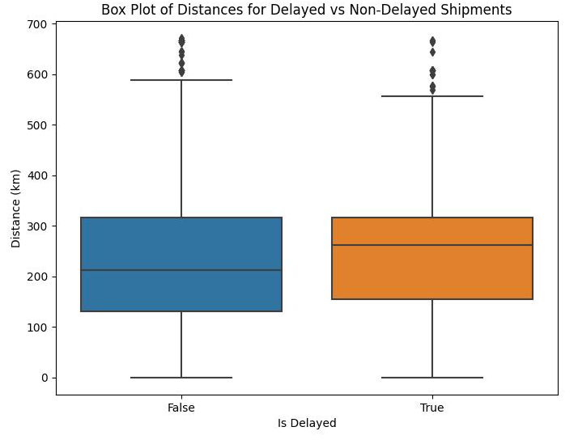
Key Findings
On-Time Deliveries:
Only 62.6% of shipments were delivered within the scheduled time frames.
Factors Contributing to Delays:
Vehicle type, distance, if ferry is on route, delivery and collection postcode, complexity of the route
Patterns and Trends:
Vehicle type (e.g. 18T Rigid and 7.5T Rigid are likely to be delayed)
Distance delivery are more on average more likely to be delayed

Slide 6
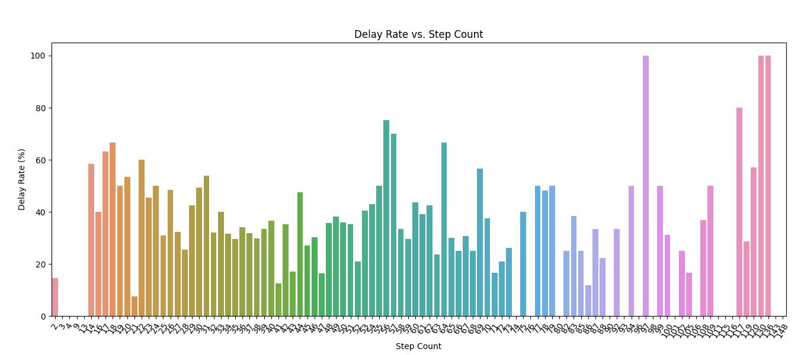
Key Findings
On average routes with more step counts (a simple measure of complexity of the route measured in number of ‘turns’) are more likely to be delayed.

Slide 7
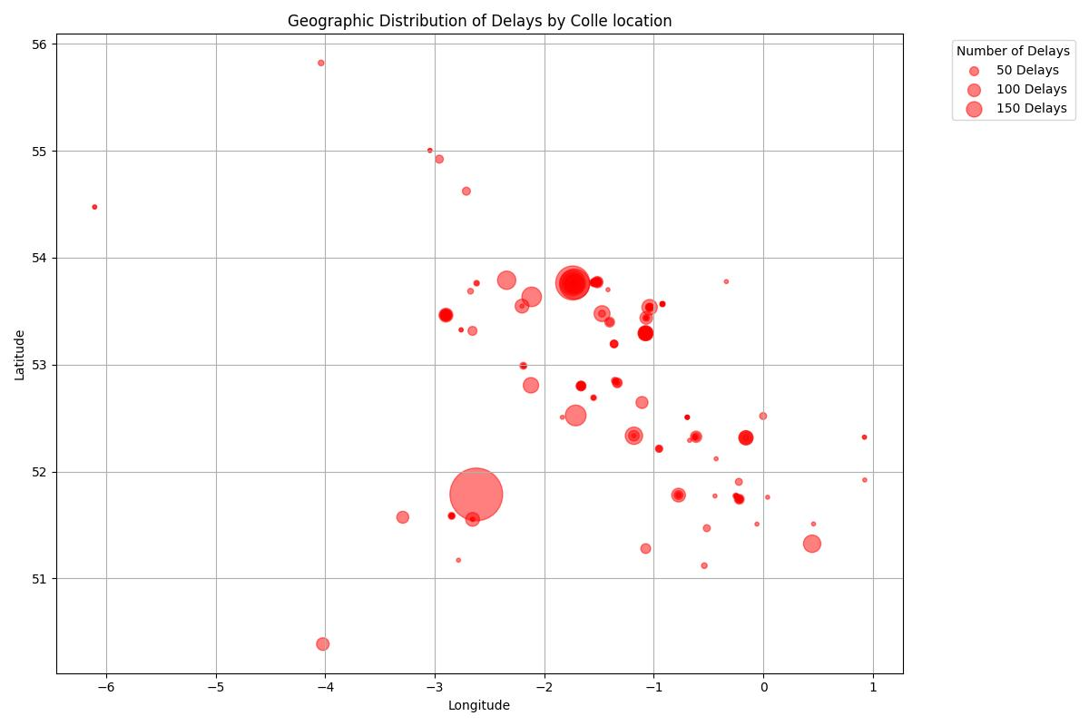
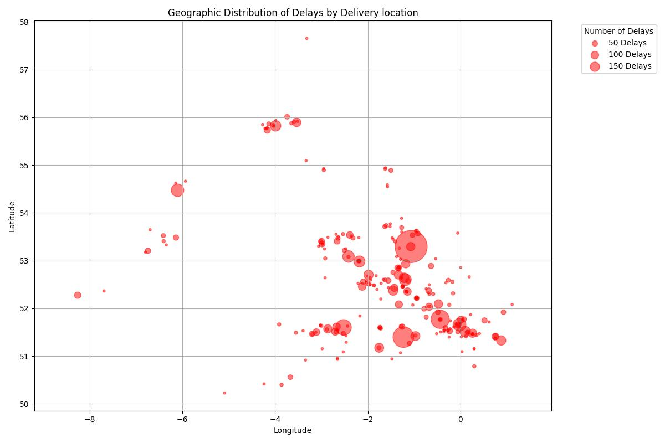
Key Findings
Certain delivery locations are more likely to be delayed.
Similarly, some collection locations are associated with delayed.
Our machine learning model predicts the delays with 77% accuracy.

Slide 8
Business Implications
Financial Implications:
Cost of Delays: Discuss the direct costs associated with delays, such as penalties, increased shipping costs, and potential loss of business.
Revenue Impact: improving delivery times can increase revenue through better customer satisfaction and repeat business. Risks Identified:
Operational Risks:
Market Risks: In competitive markets, failure to deliver on time can lead to a loss of market share as customers move to competitors.

Slide 9
Next Steps
1. Further Areas of Analysis
Historical Performance Analysis: Deep dive into historical data to identify trends and patterns in shipment delays. Look at seasonality, specific carriers, and route efficiencies.
Real-Time Data Integration: Analyze the impact of integrating real-time data feeds into the prediction model, such as traffic updates, weather forecasts, and real-time vehicle tracking. Utilize advanced machine learning models that can factor in a broader range of variables,.
Advanced analytics : E.g. apply a multitasking model that can predict likelihood of delay as well length of delay
Route Optimization: Explore simulations to find the most efficient routes and schedules based on historical data and predictive models.
2. Additional Data to Be Collected
Traffic and Weather Data: Regular updates on road conditions and weather that could impact delivery times.
Carrier Performance Metrics: Detailed logs of individual carrier performance, including times of pickups and deliveries, vehicle maintenance records, and driver feedback.

Slide 10
Proposed Timeline for Implementing Recommendations
Short-Term (1-3 Months):
Conduct initial data audit to identify existing data gaps (Traffic congestion, Weather conditions, Route distance and complexity, Vehicle-related issues).
Begin strategies to collect additional data types, such as traffic and weather data from different APIs.
Implement basic enhancements to the predictive model using additional historical data.
Medium-Term (4-6 Months):
Develop and test advanced predictive models incorporating real-time data feeds.
Start route optimization experiments based on predictive outputs.
Collect and analyse initial feedback from enhanced tracking systems.
Long-Term (6-12 Months):
Fully integrate advanced predictive analytics into daily operations.
Evaluate the effectiveness of route optimization and adjust as necessary.
Review and refine the predictive model based on new data and feedback.

